Slide 1
Parent Meeting
Set 1 Sounds
Notes:
Approximately 20 minutes is needed for this session.
Notes are provided to help you lead the presentation.
Notes in italics are for your attention only.
This bitesize parent session is best used alongside a demo lesson of teaching a Set 1 sound to children. Alternatively, you may wish to use an in-action film from the Online subscription.
Provide copies of ‘Reading at Home Booklet 1’ from Oxford Owl for each parent.

Slide 2

How we teach phonics at Hazel Wood
We use a systematic approach to teaching phonics at Hazel Wood. We use the phonics programme, Read, Write Inc
The sounds are split up into Set 1, Set 2 and Set 3 sounds

Slide 3
The simple code: Set 1 and 2 sounds
Notes:
Read Write Inc, Phonics makes learning to read easy for children because we start by teaching them just one way of reading and writing every sound. Here they are on the Simple Speed Sounds chart.
We teach Set 1 sounds first - (sounds as far as a e i o u). Then Set 2 – one way to read and write each of the long vowel sounds.

Slide 4
The complex code: Set 3 sounds
Notes:
Then we teach children another way to read the sound, and then another until they can read the most common words in English. These are on the complex Speed Sounds Chart.

Slide 5
Speed Sounds Set 1
Notes:
Children need to know sounds – not letter names – to read words.
We say the sounds in a way to make them easy to blend into a word.
We aim to eliminate the ‘uh’ at the end of the sound. This is called a ‘schwa’ sound.
We say ‘c’ ‘a’ ‘t’ rather than cuh a tuh.
Use MTYT to teach each of the Set 1 sounds to parents.

Slide 6

A speed sounds lesson -Picture Phrases
The sound and picture
word is introduced to
the children.
The sound is hidden in the pack of sounds the children have already learnt. Then the children say all of the sounds.
Notes:
We use a brief story and a picture phrase to help children to remember the Set 2 and Set 3 sounds.
For example, ay, may I play? aw, yawn at dawn.
We teach children to read and write three new Set 2 or 3 sounds each week.
We review the sounds we’ve taught before until they can read them speedily.

Slide 7
Teach something new…review, review review!
Notes:
We teach children to read and write a new sound each day.
We review the sounds we’ve taught before until they can read them speedily.

Slide 8

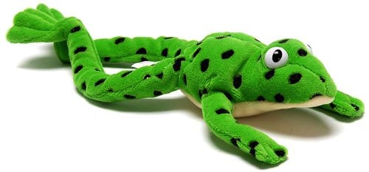

Sounds + blending = word reading
+
=
Notes:
When children can read sounds speedily, like this, (show how speedily this needs to be) and understand Fred (m-a-t...mat) (click), they can decode words.

Slide 9
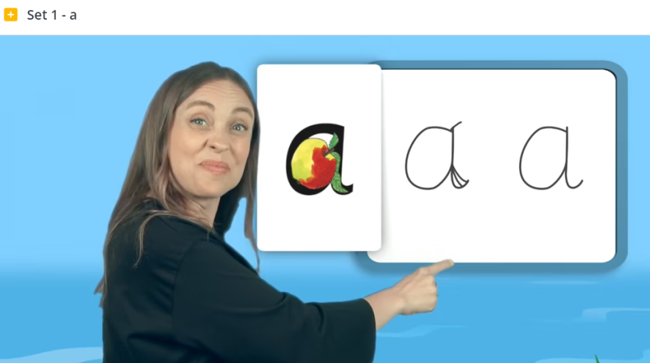
The Virtual Classroom
Each week your child's teacher will add the sounds we have been learning to the Seesaw app.
Set aside 10 minutes to watch a film with your child each day.
Find a quiet space for your child to watch the film on a laptop or tablet.
Praise your child as they join in with the lesson – make it fun!
The more they practice using these films, the
quicker they’ll learn to read.
Notes:
We will send you links to the films via email/ upload links to Google classroom/ Class Dojo etc.
When you receive the link, simply click on it . . . and press play.
Set aside 10 minutes to watch a film with your child each day.
Find a quiet space for your child to watch the film on a laptop or tablet.
Praise your child as they join in with the lesson – make it fun!
The more they practise using these films, the quicker they’ll learn to read.

Slide 10

Teaching letter formation
Notes:
Alongside learning to read each sound, children use a handwriting phrase linked to the picture mnemonic to learn to form each letter correctly.
e.g. down Maisie, and over the mountains.
Use these handwriting phrases when practising writing at home with your child.
Avoid using these to read the sound.
I will give you a handout of these handwriting phrases when you leave today.

Slide 11
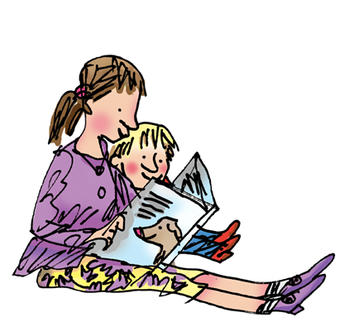
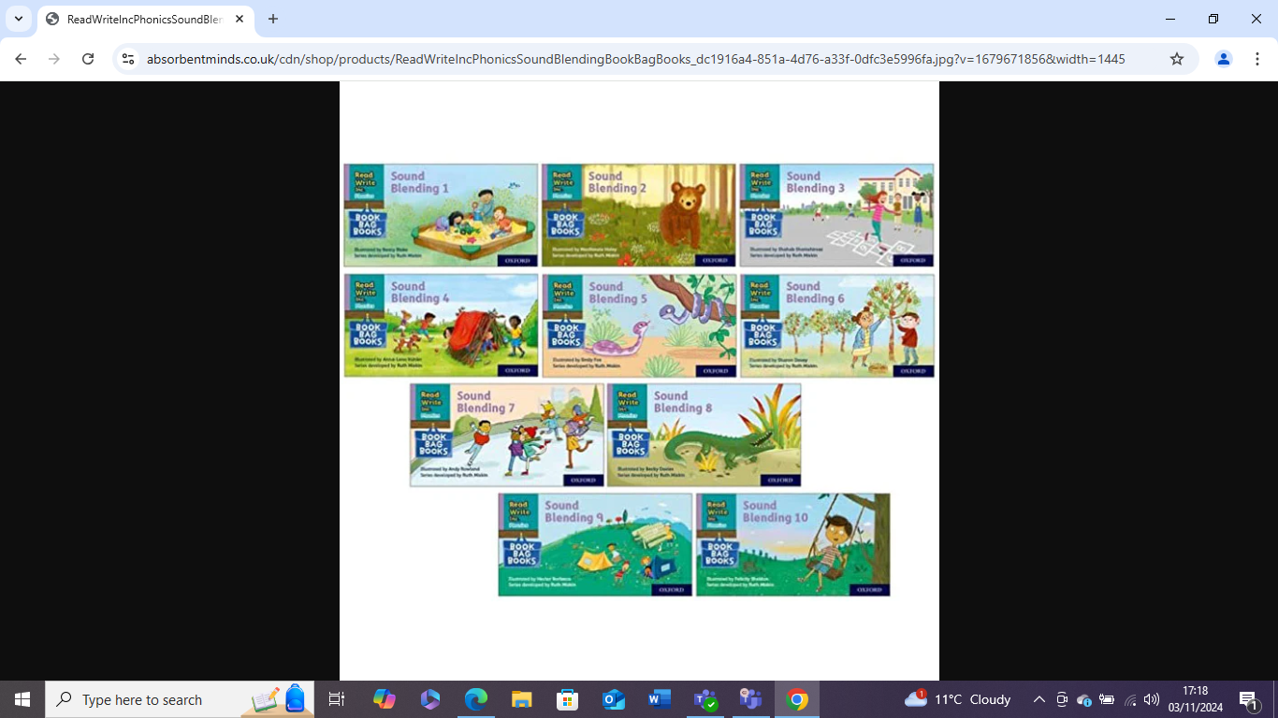
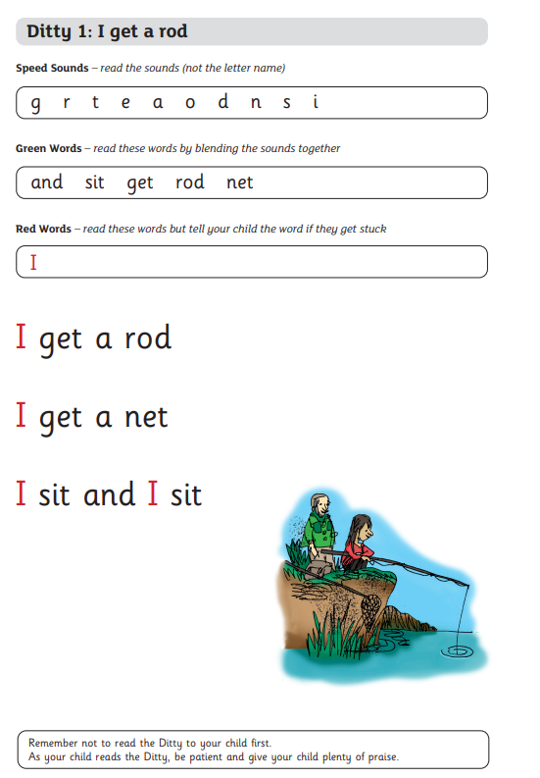
How to help your child read at home…
Reading wordless books
Looking at the pictures and asking questions about what they can see. Making up different stories and encourage imaginative story telling.
Sound blending books
Encourage your child to "Fred talk"
(say the sounds) and then blend the sounds together to read the word. Model the blending process if needed using the picture clue to support reading.
Ditty sheets
Once your child has developed their blending skills and become more confidence, they will bring home ditty sheets. These sheets help to revisit their sounds and words they can read by blending. The words are then put into simple sentences with red words that cannot be sounded out.

Slide 12
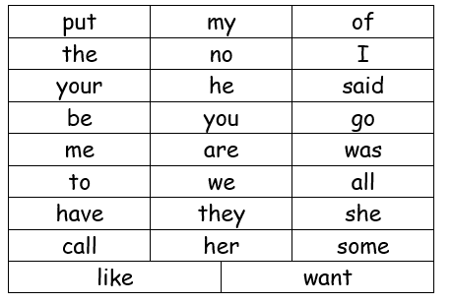
Red words
Red words are words that cannot be sounded out.
Children need to learn these words by sight.
If they can read these red words quickly and confidently their reading will become more fluent.

Slide 13

Promoting and encouraging reading
Read the same book 5 times at home.
This allows children to feel more confident and develop fluency with their reading.
Each time your child reads at home they will
receive a stamp.
They can collect a special bookmark and badges as a reward for reading.

Slide 14


