Slide 1
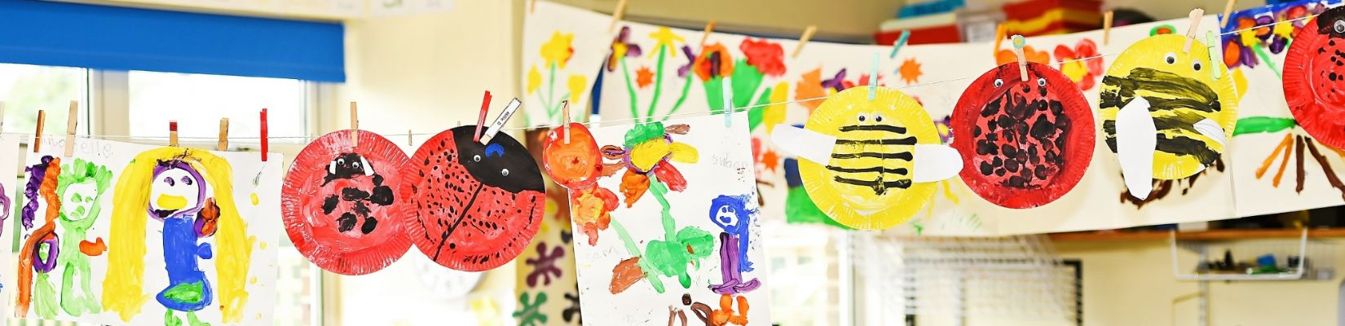

Welcome to Year 2
Maple Class
Teacher: Mrs Fisher
Teaching Assistants: Mrs Richardson and Mrs Dickenson

Slide 2

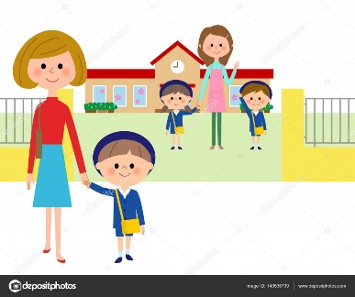
Morning Routine
Meet and Greet
Put coats, bookbags and water bottles away
Morning jobs
Carpet time with register and lunch choices
Pick-up Routine
Adult collecting at the end of the day to wait outside on the playground.
Please line up on the second row in from the school gate.
Class adults to see each child out one at a time to the person who is collecting each day.

Slide 3
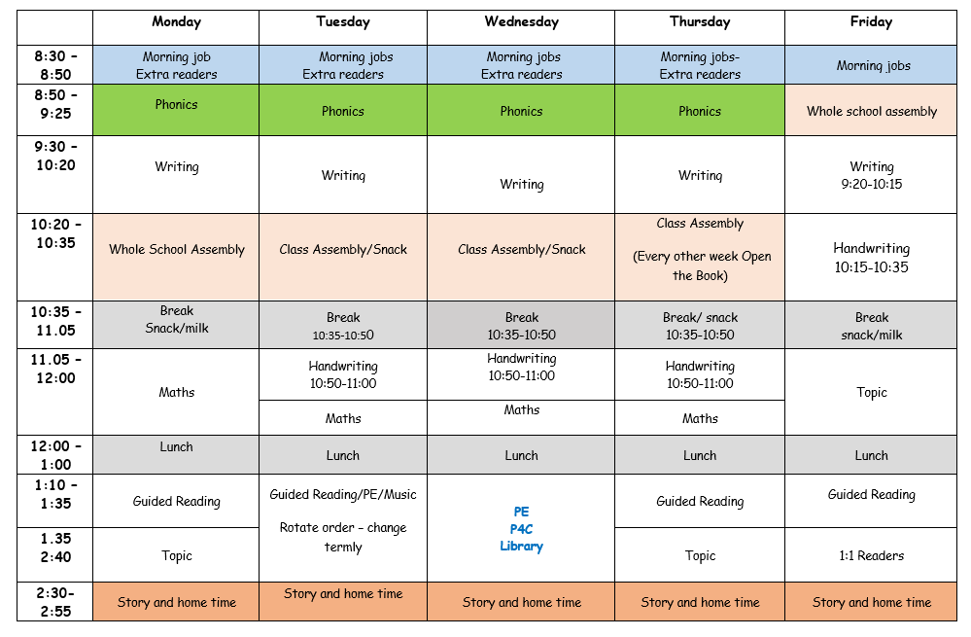
Typical Structure of the Week in Maple
Subjects Covered in Year 2
Literacy:
Writing and Reading
Mathematics
Science
Design and Technology
Art
Geography
History
PSHE
PE
Music
RE
We follow the National Curriculum for each of our subjects.

Slide 4
‘Parents as Partners’
Open door policy
Curriculum News
Curriculum workshops
Social media posts about learning and events
Parent’s Evenings
School Newsletters
Notes:
Open – Door Policy Adults in the classroom and around the school are always willing to help – The office staff are very warm and friendly so please do not hesitate to call the school or come in with any queries. After school club, early bird club etc.

Slide 5
Reading Expectations
Reading at home is a simple but powerful way to support your child in Key Stage 1. It builds confidence, strengthens skills learned in school, and helps develop a love of books and learning—all while enjoying special time together.
Please read with your child at least 5 times a week
Daily reading strengthens essential literacy skills like phonics, vocabulary, and comprehension. It supports overall academic progress and helps children become confident, independent learners.

Slide 6
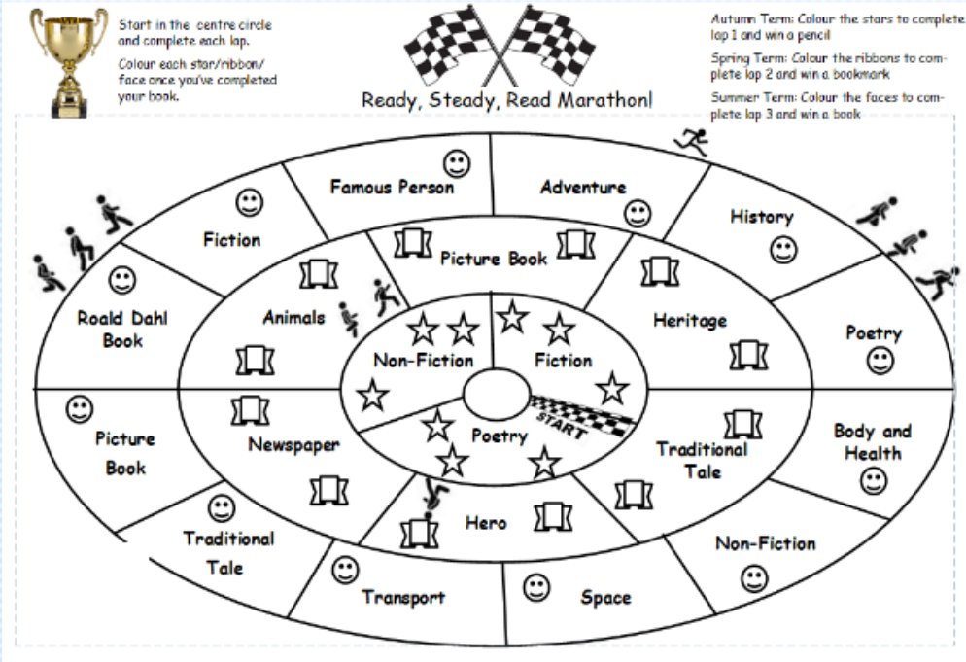
Reading Reward Challenge: Year 2
The children will have a marathon sheet stuck into the back of the reading record.
Children start on a new lap each term colouring in each icon when complete. They must record all of the books they read for the marathon in their reading record. The completion of a lap a term will earn a reward in the end of term reading celebration assembly.
If your child does not wish to complete the marathon but reads 50 times a term, they will earn a certificate in the end of term reading celebration assembly.

Slide 7
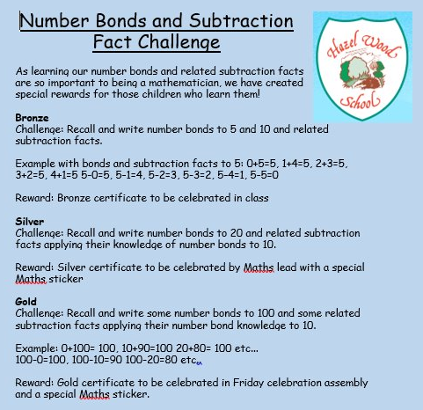
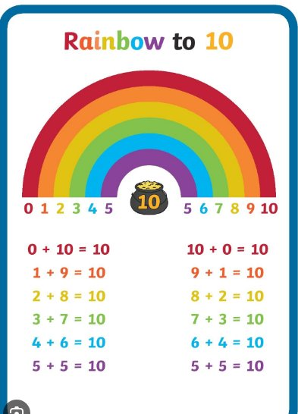
Maths Reward Challenge
Number bonds are vital to supporting children’s understanding and application of mathematical concepts.

Slide 8
Key information for Maple Class
Please make sure your child brings their library and phonics book every Wednesday.
We change banded reading books on different days, so please don’t forget to send them each day ready to be swapped.
Children should come to school in their PE kits on their PE days— Maple PE days are on Tuesday and Wednesday.

Slide 9
We look forward to your child joining us in Maple Class!
If you have any questions, please don’t hesitate to ask any of the members of staff.

