Slide 1
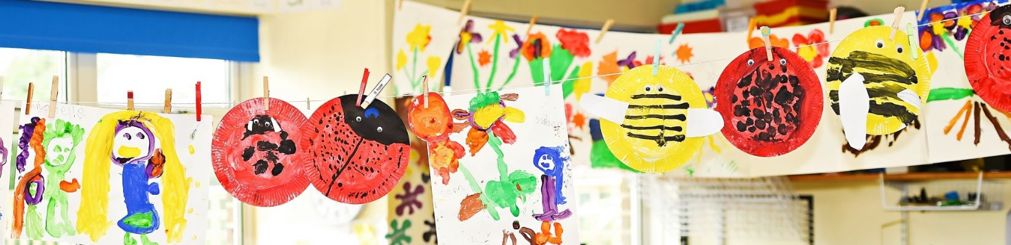

Welcome to Beech Year 1
Teachers: Mrs West and Miss Howells
Teaching Assistant: Mrs Gale and Mrs Dyer

Slide 2

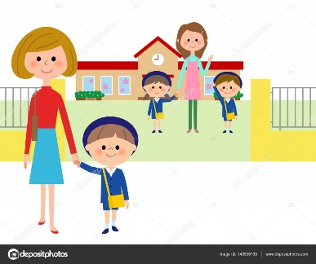
Morning Routine
‘Meet and Greet’
Put coats, bookbags and water bottles away
‘Morning jobs’
Carpet time with register and lunch choices
Pick-up Routine
Adult collecting at the end of the day to wait outside on the playground.
Please line up on the first row in from the school gate.
Class adults to see each child out one at a time to the person who is collecting each day.

Slide 3
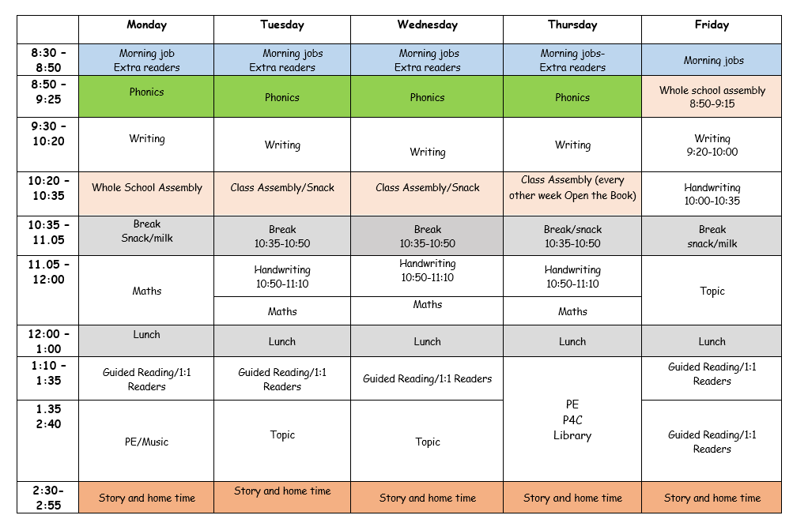
Typical Structure of the Week in Beech
Subjects Covered in KS1:
Literacy:
Writing and Reading
Mathematics
Science
Design and Technology
Art
Geography
History
PSHE
PE
Music
RE
We follow the National Curriculum for each of our subjects.

Slide 4
‘Parents as Partners’
Open door policy
Curriculum News
Curriculum workshops
Social media posts about learning and events
Parents’ Evenings
School Newsletters
Notes:
Open – Door Policy Adults in the classroom and around the school are always willing to help – The office staff are very warm and friendly so please do not hesitate to call the school or come in with any queries. After school club, early bird club etc.

Slide 5
Reading Expectations
Reading at home is a simple but powerful way to support your child in Key Stage 1. It builds confidence, strengthens skills learned in school, and helps develop a love of books and learning—all while enjoying special time together.
Please read with your child at least 5 times a week
Daily reading strengthens essential literacy skills like phonics, vocabulary, and comprehension. It supports overall academic progress and helps children become confident, independent learners.

Slide 6
Reading Reward Challenge: Year 1
The ‘5 a week’ reading challenge helps your child to read 5 times a week for 10mins.
Simply write your child’s reading book in your child’s reading diary and initial to say your child has read.
For each reading entry in the diary your child will receive a stamp and if they collect 50 stamps by the end of each term, they will win a small prize.
  Where to find the stamps?
  Once a week, when their reading books are being changed, an adult will check how far they have progressed in the challenge and stamp the diaries.

Slide 7
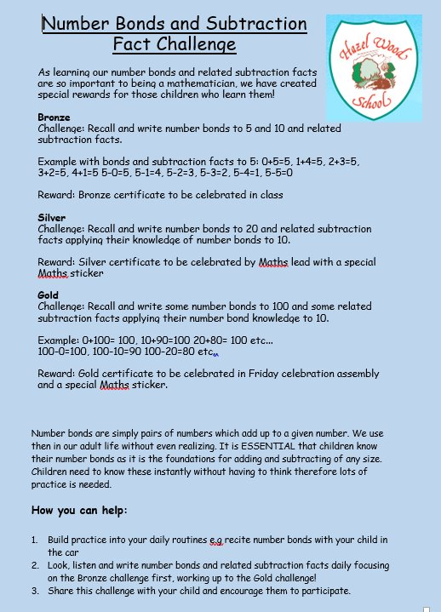
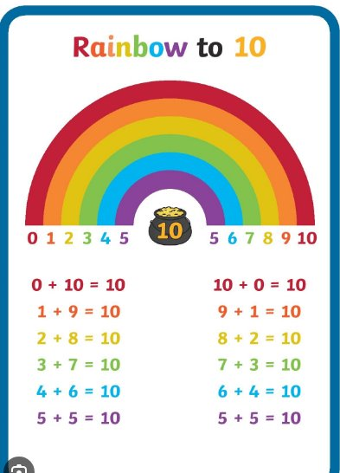
Maths Reward Challenge
Number bonds are vital to supporting children’s understanding and application of mathematical concepts.

Slide 8
Key information for Beech
Please make sure your child brings their phonics book every Wednesday and their library book every Thursday.
We change banded reading books on different days, so don’t forget to send them each day in ready to be swapped.
Children should come to school in their PE kits on their PE days— Ash PE days are on Tuesday and Thursday.

Slide 9
We look forward to your child joining us in Beech Class!
If you have any questions, please don’t hesitate to ask any of the members of staff.

