Slide 1

KS1 Maths Parent Workshop at Hazel Wood Infant school

Slide 2
Our aim is to provide opportunities to enable all children to:
• Enjoy numbers!
• Explore, investigate and get creative with numbers
• Communicate mathematical ideas with confidence
• Develop a secure understanding of mathematical foundations (fluency, reasoning and problem solving)
• Use manipulatives to demonstrate their understanding
• Recall number facts with increasing speed, fluency and accuracy

Slide 3
Fixed vs Growth Mindset - Carol Dweck
We believe that everyone can get better at maths...when they put in the effort and work at it.
We do not praise children for being clever when they succeed at something, but instead praise them for working hard.
Children learn to associate achievement with effort (which is something they can influence themselves – by working hard), not ‘cleverness’.
MISTAKES are good! It is how we learn.

Slide 4
How would you solve these calculations?
Which method would you use?
2 + 5 =
2 + 8 =
7 + 7 =
6 + 7 =
15 + 11 =
24 + 9 =
32 + 21 =
45 + 36 =
120 + 11 =
What skills were you using?
Does that method work for all the calculations?

Slide 5
How would you solve these calculations?
2 + 5 = (start with the larger number and count on)
2 + 8 = (number bonds to 10)
7 + 7 = (doubling)
6 + 7 = (near doubles, double 6 and add 1)
15 + 11 = (add 10 and then add 1)
24 + 9 = (add 10 subtract 1)
32 + 21 = (could add 20, add 1 or add tens, add units and then total)
45 + 36 = adding by partitioning 40 + 30 =70 , 5+6 (5+5= 10 – bonds, 70+ 10 = 80 , add 1 more is 81).
Notes:
Teach children skills to be able to apply to a variety questions.

Slide 6
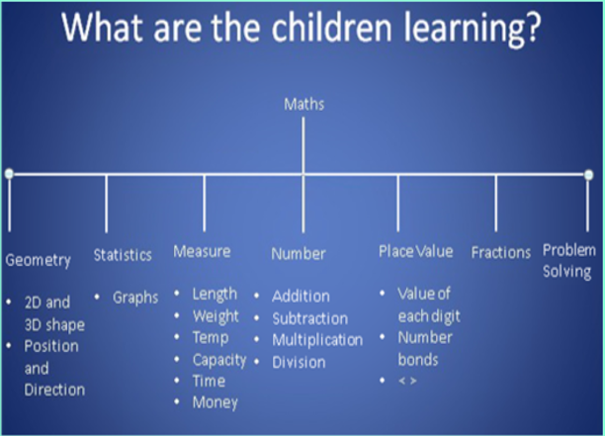
Today we will focus on:
Number: addition and subtraction, multiplication and division.
Place value: value of each digit and number bonds

Slide 7
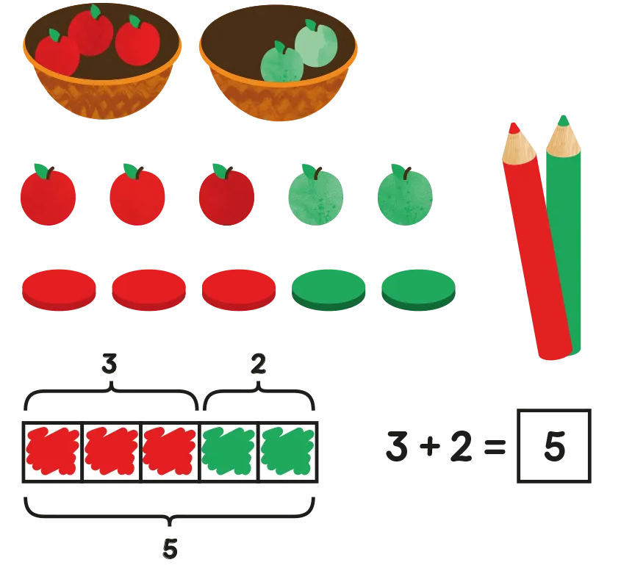
Concrete, Pictorial, Abstract (CPA)
Concrete is the “doing” stage. Every abstract concept is first introduced using physical, interactive concrete materials. For example, if a problem involves adding pieces of fruit, children can first handle actual fruit.
Pictorial is the “seeing” stage. Here, visual representations of concrete objects are used to model problems. Building or drawing a model makes it easier for children to grasp difficult abstract concepts (for example, fractions).
Abstract is the “symbolic” stage, where children use abstract symbols to model problems. Children are introduced to the concept at a symbolic level, using only numbers, notation, and mathematical symbols (for example, +, –, x, /) to indicate addition, multiplication or division.

Slide 8
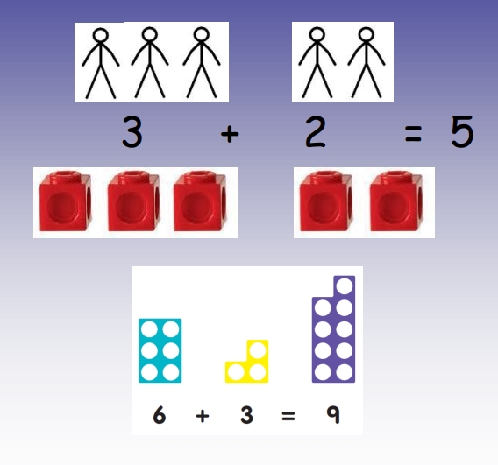
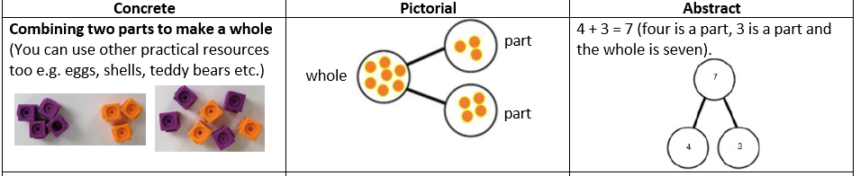
Addition (using objects and pictures)

Slide 9
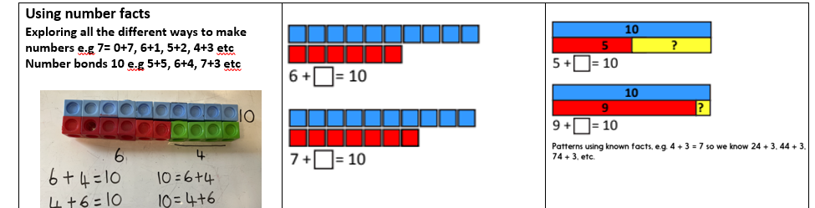
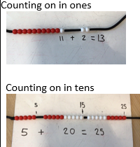
Addition: using number facts and counting on

Slide 10
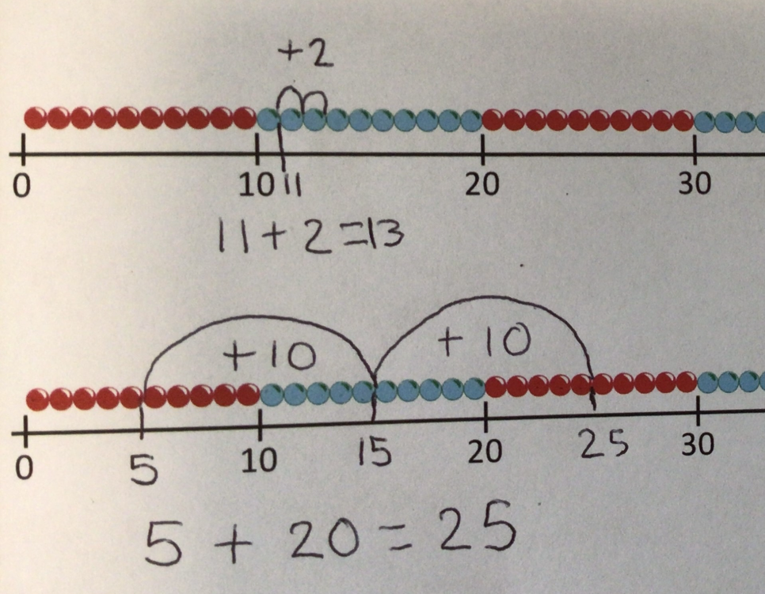
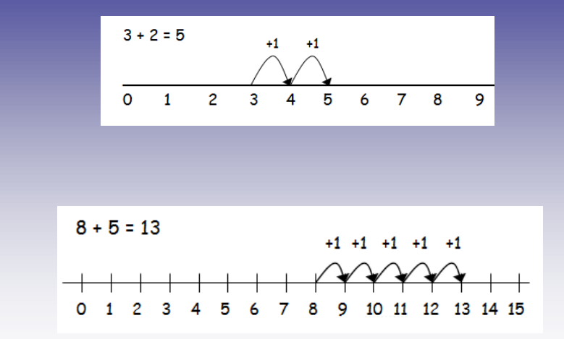
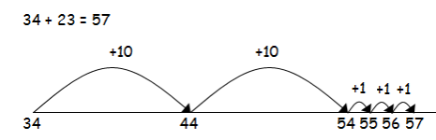
Addition: Using a number line (or beaded number line)

Slide 11
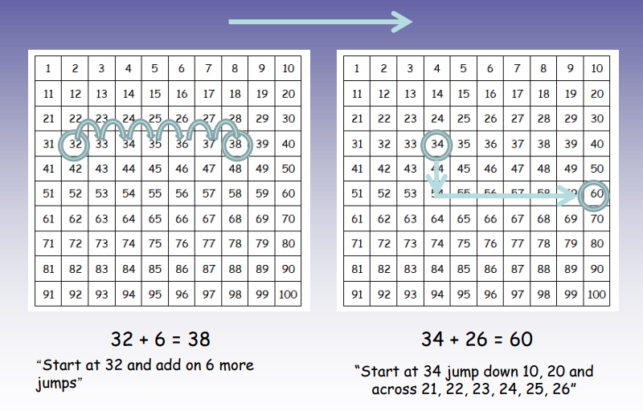
Addition: Using a number square

Slide 12
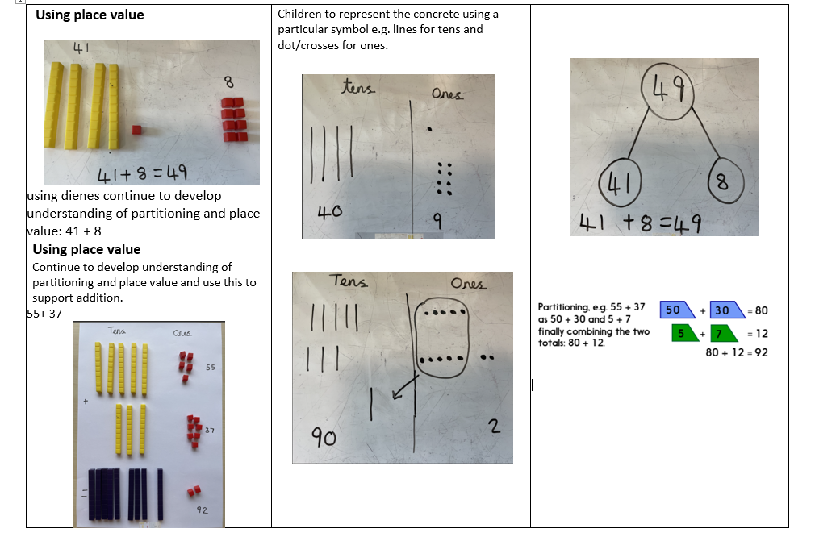
Addition using place value and partitioning
Notes:
It is so important children understand the place value of a number i.e 4 tens and 2 ones in 42.

Slide 13
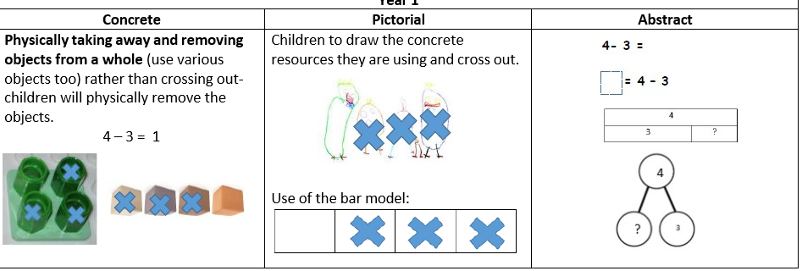
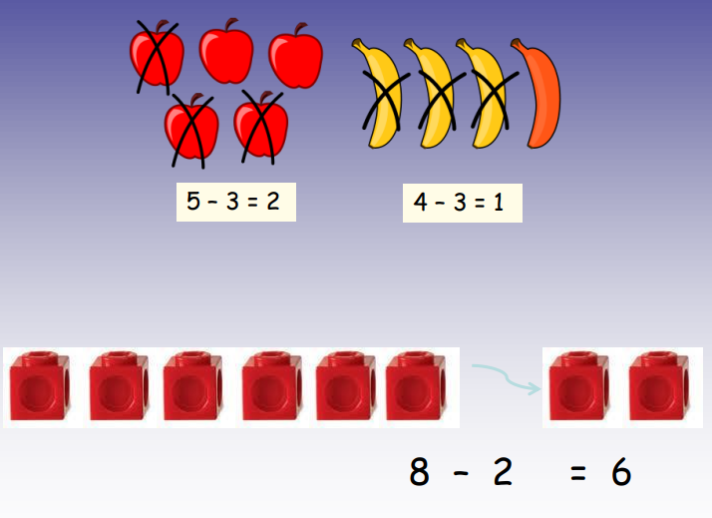
Subtraction: Physically taking away

Slide 14
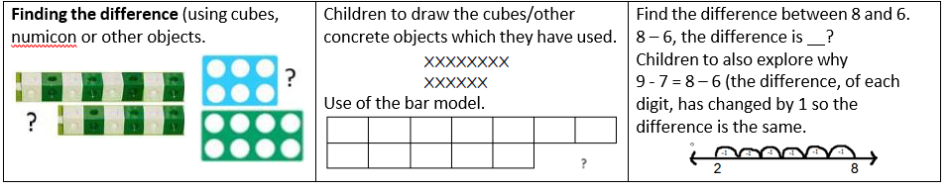
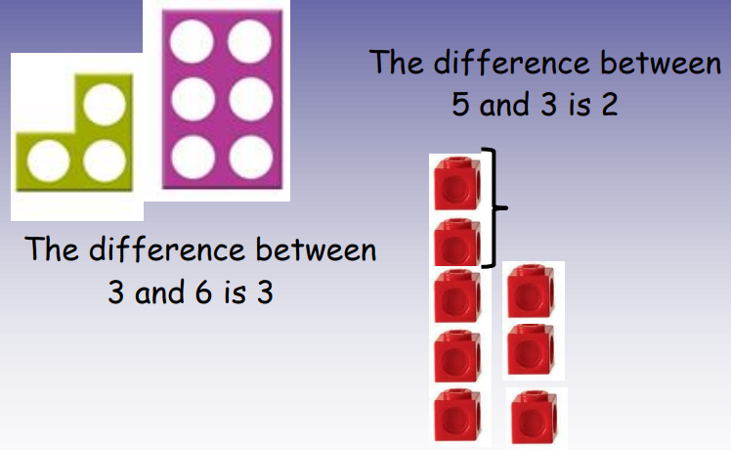
Subtraction: Finding the difference

Slide 15
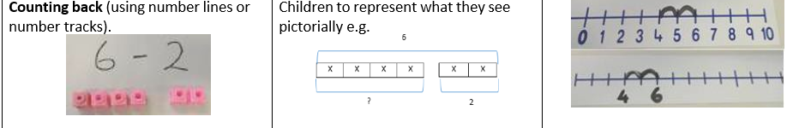
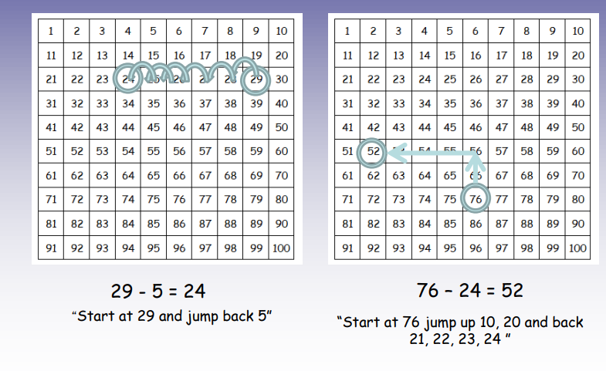
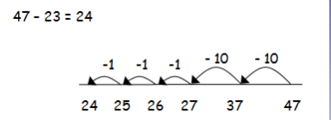
Subtraction: Counting back (objects, number line or 100 square)

Slide 16
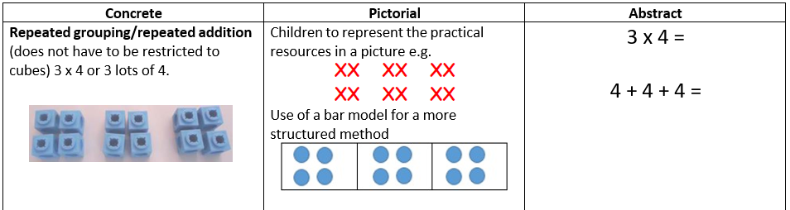
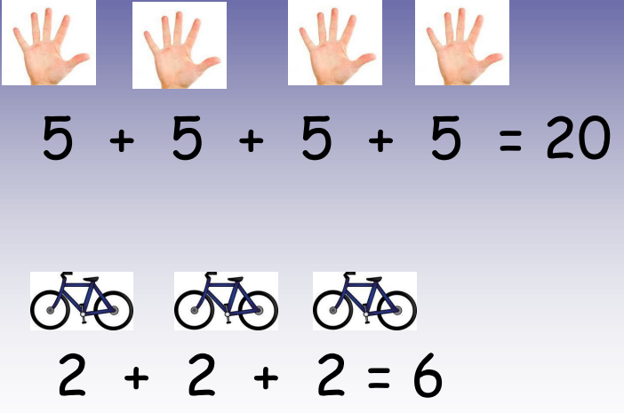
Multiplication: Repeated addition

Slide 17
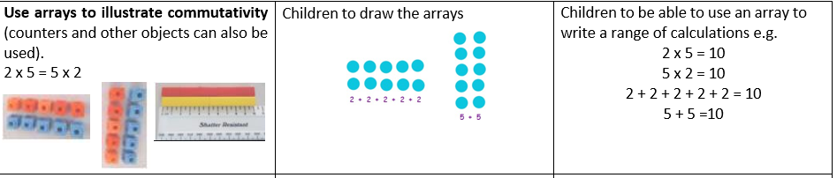
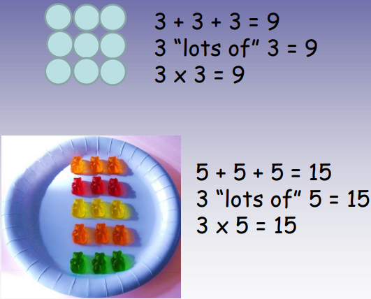
Multiplication: Using arrays

Slide 18
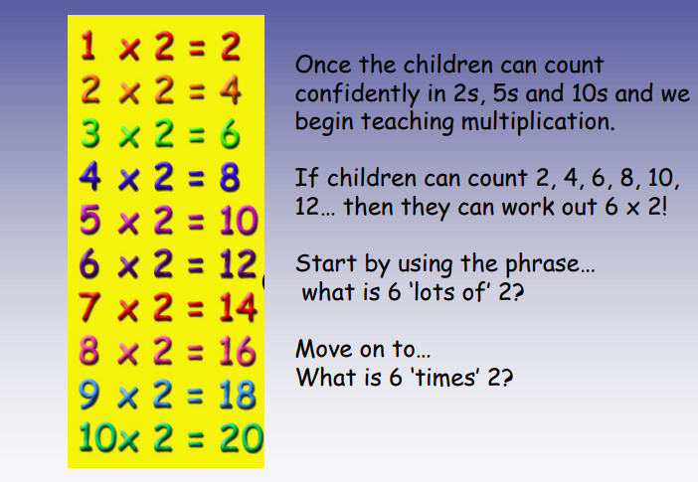
Multiplication: Mental Recall

Slide 19
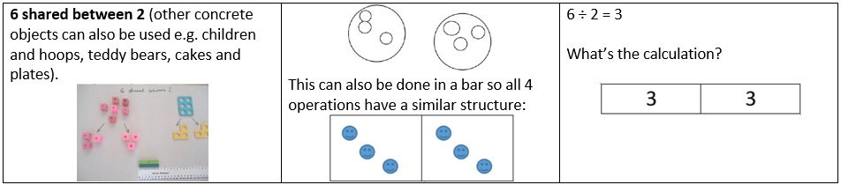
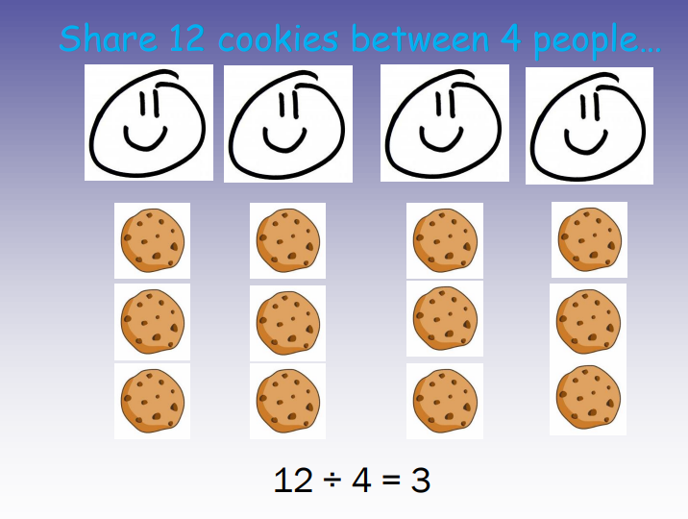
Division: Sharing

Slide 20
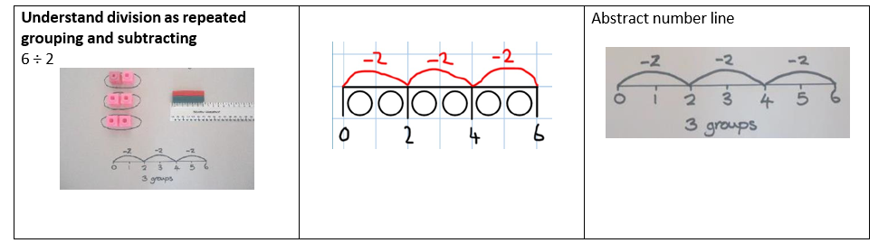
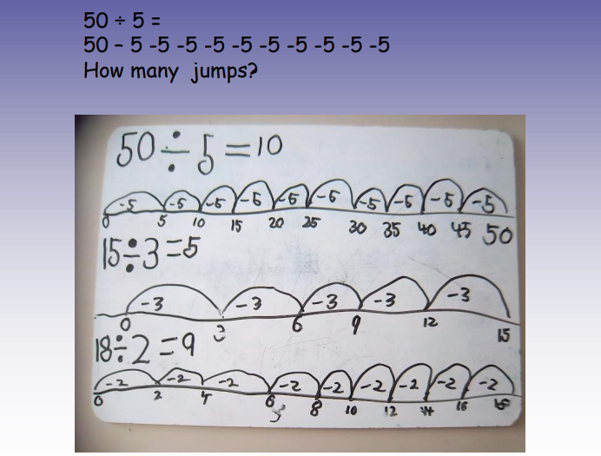
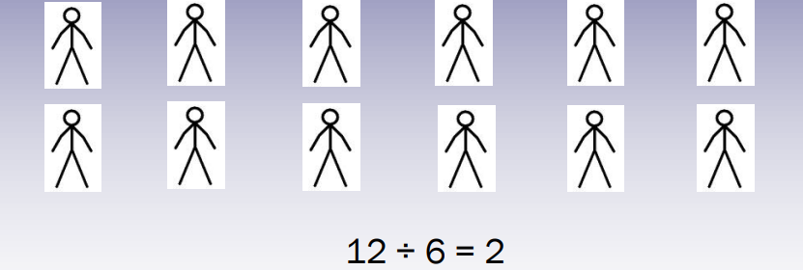
Division: Repeated grouping and subtracting
Put 12 people in 6 groups. How many people in each group?

Slide 21
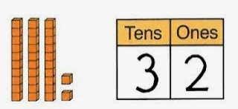
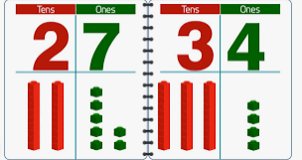
Place value: Understanding the value of each digit

Slide 22
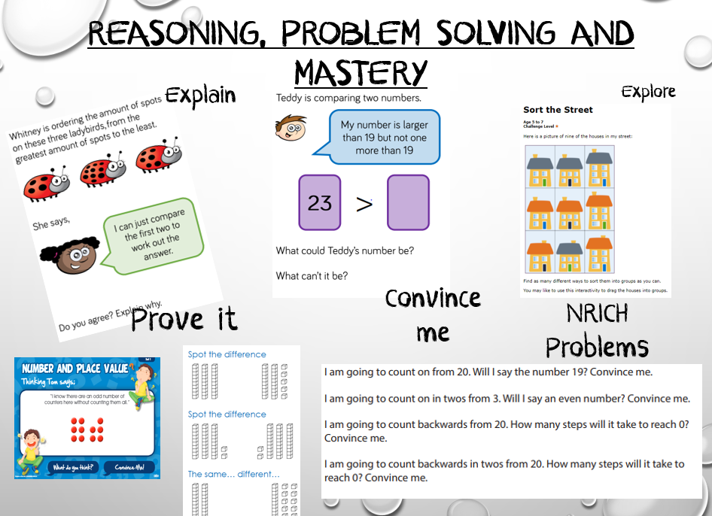
Notes:
Fluency in maths is about developing number sense and being able to choose the most appropriate method for the task at hand; to be able to apply a skill to multiple contexts.
Problems should be seen as questions for which children do not have ready-made solutions.
Reasoning in maths is the process of applying logical thinking to a situation to derive the correct problem solving strategy for a given question, and using this method to develop and describe a solution.

Slide 23
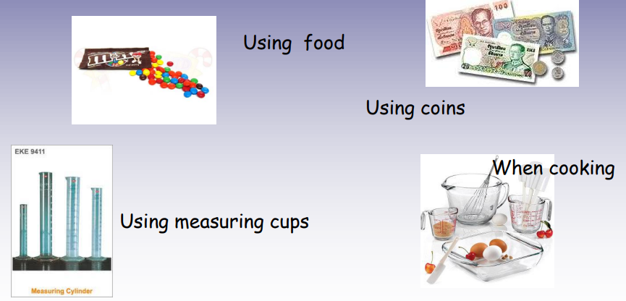
How to help your child:
Count in 2, 5 and 10s daily forwards and backwards
Number bonds to 10 and 20
Count on or back from any number up to 100 daily
Ask your class teacher if there are any maths areas your child would benefit from practising at home
Counting on from any number

Slide 24
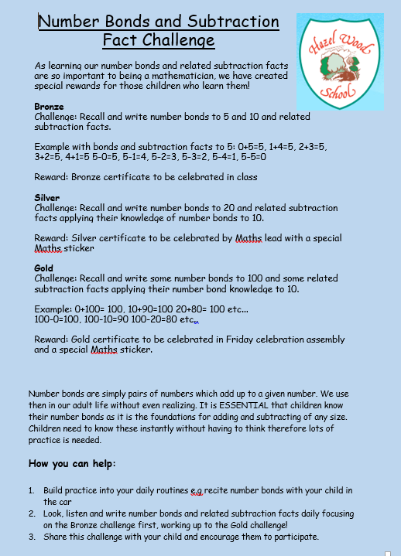
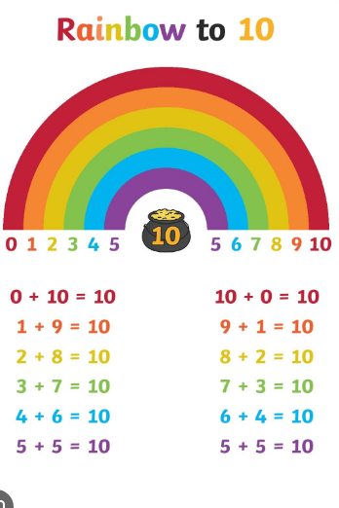
Number bonds
Number bonds are vital to supporting children’s understanding and application of mathematical concepts.

Slide 25
Useful websites to use for Maths games:
https://ictgames.com/mobilePage/index.html
https://www.bbc.co.uk/games/embed/karate-cats-2
www.mathszone.co.uk
www.bbc.co.uk/bitesize/primary
www.maths-excerise-for-kids.com
www.primarygames.com/maths
www.theschoolrun.com/primary-numeracy-glossary-for-parents
https://home.oxfordowl.co.uk/maths/primary-number-place-value/number-place-value-year-2-age-6-7/
https://www.mathplayground.com/math-games.html
https://nrich.maths.org/9086
https://www.topmarks.co.uk/maths-games/hit-the-button

