Slide 1

YR Maths Parent Workshop at Hazel Wood Infant school

Slide 2
Our aim is to provide opportunities to enable all children to:
• Enjoy numbers!
• Explore, investigate and get creative with numbers
• Communicate mathematical ideas with confidence
• Develop a secure understanding of mathematical foundations
• Use manipulatives to demonstrate their understanding
• Recall number facts with increasing speed, fluency and accuracy

Slide 3
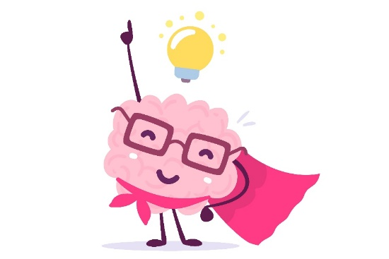
Fixed vs Growth Mindset
We believe that everyone can get better at maths...when they put in the effort and work at it.
We do not praise children for being clever when they succeed at something, but instead praise them for working hard.
Children learn to associate achievement with effort (which is something they can influence themselves – by working hard), not ‘cleverness’.
MISTAKES are good! It is how we learn.

Slide 4
Early Learning Goals (ELG) for Maths- End of Year R
There are two strands of maths in the Early Years Curriculum:
Number (ELG)
- Have a deep understanding of number to 10, including the composition of each number;
- Subitise (recognise quantities without counting) up to 5;
- Automatically recall (without reference to rhymes, counting or other aids) number bonds up to 5 (including subtraction facts) and some number bonds to 10, including double facts.
Numerical Pattern(ELG)
- Verbally count beyond 20, recognising the pattern of the counting system;
- Compare quantities up to 10 in different contexts, recognising when one quantity is greater than, less than or the same as the other quantity;
- Explore and represent patterns within numbers up to 10, including evens and odds, double facts and how quantities can be distributed equally.

Slide 5
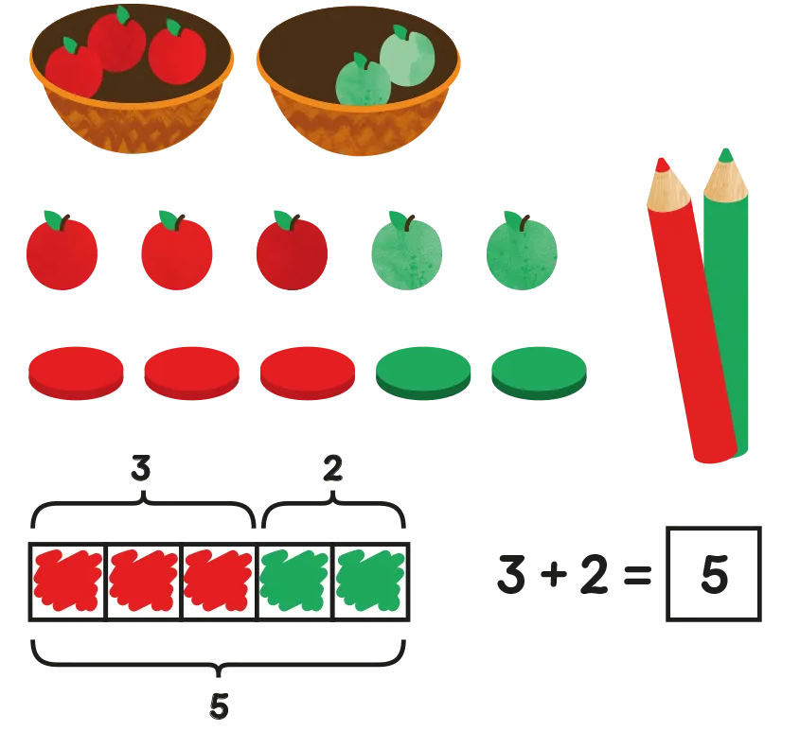
Concrete, Pictorial, Abstract (CPA)
Concrete is the “doing” stage. Every abstract concept is first introduced using physical, interactive concrete materials. For example, if a problem involves adding pieces of fruit, children can first handle actual fruit.
Pictorial is the “seeing” stage. Here, visual representations of concrete objects are used to model problems. Building or drawing a model makes it easier for children to grasp difficult abstract concepts (for example, fractions).
Abstract is the “symbolic” stage, where children use abstract symbols to model problems. Children are introduced to the concept at a symbolic level, using only numbers, notation, and mathematical symbols (for example, +, –, x, /) to indicate addition, multiplication or division.

Slide 6
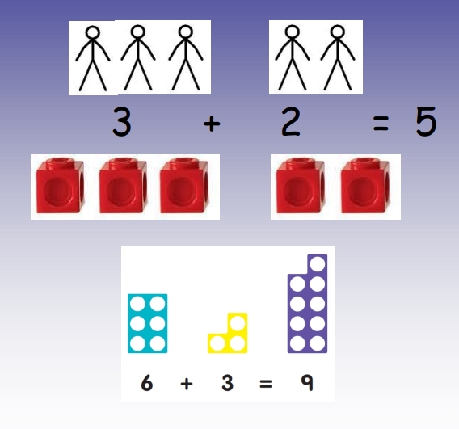
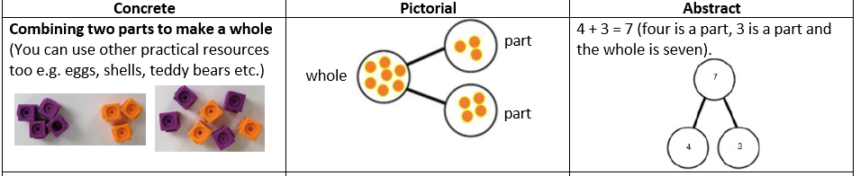
Addition (using objects and pictures)

Slide 7
Maths In Year R
Maths is everywhere!
Children learn key maths skills during play in both the outside and inside provision alongside targeted maths teaching.
Daily maths sessions include:
Whole class input
Small focused activity with an adult
Rotation of independent maths activities
Being active!

Slide 8
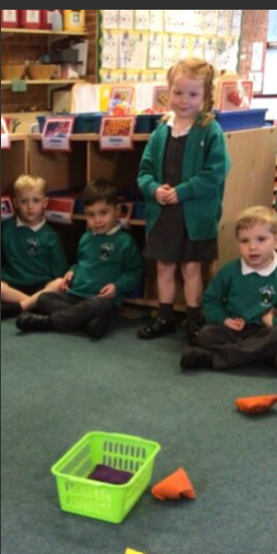
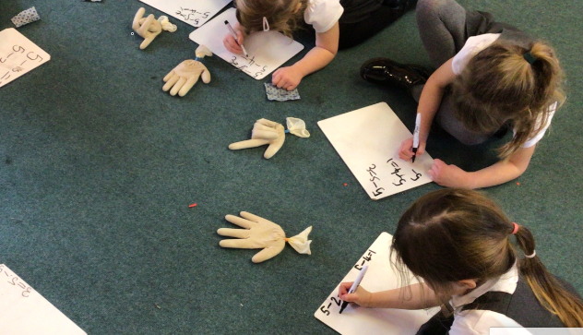
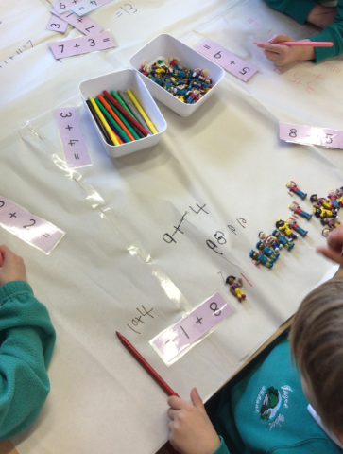
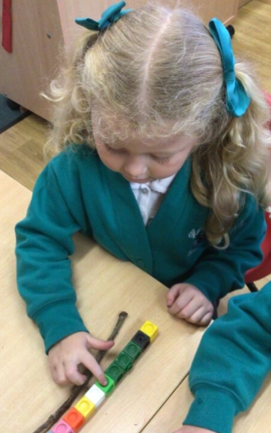
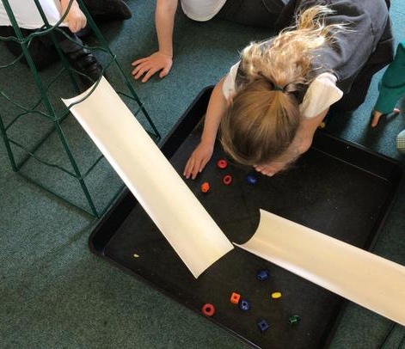
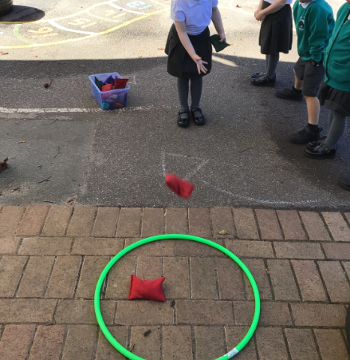
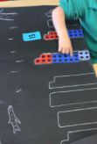
Maths In Year R is always fun!

Slide 9
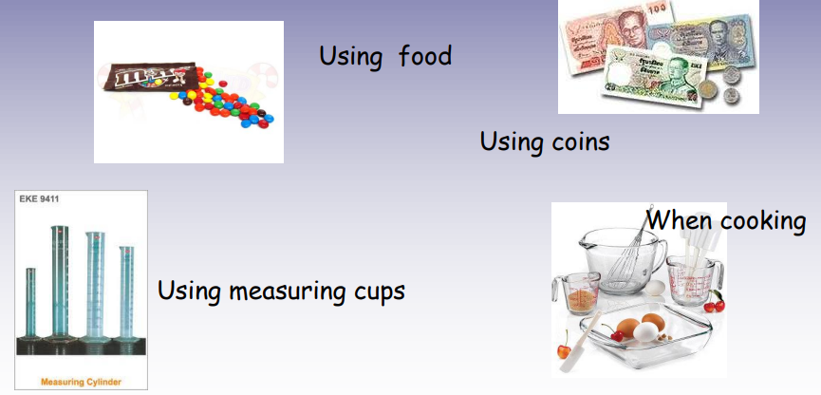
How to help your child:
Little and often.
Finding maths opportunities in everyday life- counting stairs, finding pairs, making patterns and halving objects such as food.
Play board games- snakes and ladders, snap, connect 4 etc.
Key instant recall facts half termly sheet.
Sorting things into shapes
Ordering things by size.
You can use a variety of resources at home to use to develop your child's number skills such as:
Sweets, food and biscuits
Counting and sorting toys such as cars or teddies
Using number cards
Any natural objects from walks or the garden

Slide 10
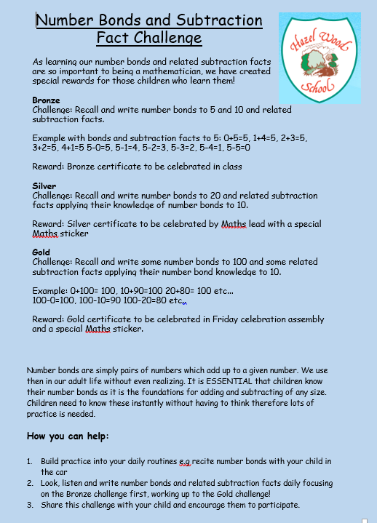
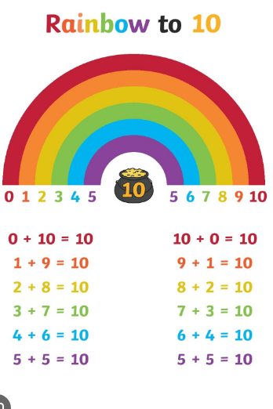
Number bonds
Number bonds are vital to supporting children’s understanding and application of mathematical concepts.

Slide 11
Useful websites to use for Maths games:
https://ictgames.com/mobilePage/index.html
https://www.bbc.co.uk/games/embed/karate-cats-2
www.mathszone.co.uk
www.bbc.co.uk/bitesize/primary
www.maths-excerise-for-kids.com
www.primarygames.com/maths
www.theschoolrun.com/primary-numeracy-glossary-for-parents
https://www.mathplayground.com/math-games.html
https://nrich.maths.org/9086
https://www.topmarks.co.uk/maths-games/hit-the-button
https://whiteroseeducation.com/parent-pupil-resources/maths/home-learning

