Slide 1
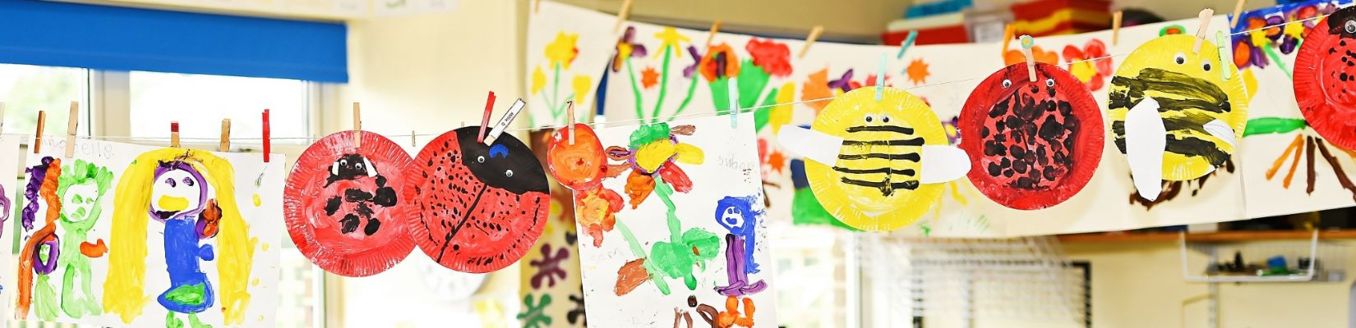

Welcome to Beech Class!
Teacher: Miss Mote
Teaching Assistant: Mrs Richardson

Slide 2

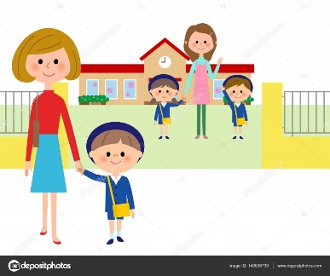
Morning Routine
‘Meet and Greet’
Put coats, bookbags and water bottles away
Morning jobs
Carpet time with register and lunch choices
Pick-up Routine
Adult collecting at the end of the day to wait outside on the playground.
Please line up on the first row in from the school gate.
Class adults to see each child out one at a time to the person who is collecting each day.

Slide 3
Typical Structure of the Week in Beech
 | Monday | Tuesday | Wednesday | Thursday | Friday
8:30 – 8:50 | Morning jobs Register | Morning jobs Register | Morning jobs Register | Morning jobs Register | Morning jobs Register
8:50 – 9:30 | Phonics | Phonics | Phonics | Phonics | Celebration Assembly
9:30 – 10:20 | Session 1 | Session 1 | Session 1 | Session 1 | Guided Reading
10:20 – 10:35 | Assembly | Assembly | Class Assembly | Assembly
10:35 – 11.05 | Break/snack | Break/snack | Break/snack | Break/snack | Break/snack
11.05 – 12:00 | Session 2 | Session 2 | Session 2 | Session 2 | Guided Reading
 |  |  |  |  | Music
12:00 – 1:00 | Lunch | Lunch | Lunch | Lunch | Lunch
1.05 - 1.30 | Interventions/ Handwriting | Interventions/ Handwriting | Interventions/ Handwriting | Interventions/ Handwriting | Interventions/ Handwriting
1:30 – 2:40 | Session 3 | Session 3 | Session 3 | Session 3 | PSHE
2:40-2:55 | Story and home time | Story and home time | Story and home time | Story and home time | Story and home time
Subjects Covered in KS1:
Literacy:
Writing and Reading
Mathematics
Science
Design and Technology
Art
Geography
History
PSHE
PE
Music
RE
We follow the National Curriculum for each of our subjects.

Slide 4
‘Parents as Partners’
Open door policy
Curriculum News
Curriculum workshops
Social media posts about learning and events
Parent’s Evenings
School Newsletters
Notes:
Open – Door Policy Adults in the classroom and around the school are always willing to help – The office staff are very warm and friendly so please do not hesitate to call the school or come in with any queries. After school club, early bird club etc.

Slide 5
Reading Expectations
Reading at home is a simple but powerful way to support your child in Key Stage 1. It builds confidence, strengthens skills learned in school, and helps develop a love of books and learning—all while enjoying special time together.
Please read with your child at least 5 times a week
Daily reading strengthens essential literacy skills like phonics, vocabulary, and comprehension. It supports overall academic progress and helps children become confident, independent learners.

Slide 6
Reading Reward Challenge: Year 1
The ‘5 a week’ reading challenge helps your child to read 5 times a week for 10mins.
Simply write your child’s reading book in your child’s reading diary and initial to say your child has read.
For each reading entry in the diary your child will receive a stamp and if they collect 50 stamps by the end of each term, they will win a small prize.
  Where to find the stamps?
  Once a week, when their reading books are being changed on a Friday, an adult will check how far they have progressed in the challenge and stamp the diaries.

Slide 7
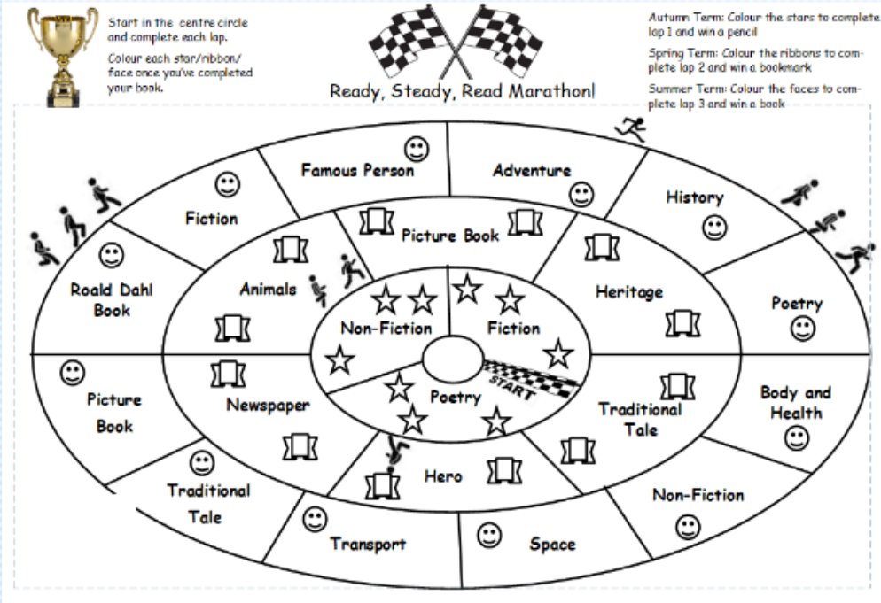
Reading Reward Challenge: Year 2
The ‘Ready, Steady, Read Marathon’ challenges your child to read a range of genres and themed books from the library. Children will be given a marathon sheet, which will be glued into the back of their reading diary.
Simply start in the middle loop and read a book from each section.
Once completed, your child can colour in the star, ribbon or face and write the book title in their reading diary to show they have read the book. For each lap fully completed your child can win a small prize.
Once a week on a Friday, when their reading books are being changed, an adult will check how far they have progressed in the marathon.

Slide 8
Hold a sentence
Holding a sentence helps children learn to think about what they want to write, remember it clearly, and then write it down accurately—building their confidence and writing skills step by step.
The children will come home with a hold a sentence book. Parents are encouraged to support their child’s writing at home using the sentence provided on the sticker at the back of the book. Books are sent home each Friday and must be returned by Thursday for a new sticker. Children earn a stamp each week for practicing their sentences and will receive any extra play at the end of each term.
The steps to support your child who hold a sentence include:
Read the sentence aloud with your child multiple times. Identify the capital letter and full stop together. 2. Discuss any spelling patterns in the sentence. 3. Have your child write the sentence at the front of the book. 4. Encourage correct use of capital letters, finger spaces, and full stops. 5. Praise your child and promote neat handwriting on every line. 6. Review the sentence with your child using the sticker as a reference. 7. Support and correct any errors. 8. Practice the sentence throughout the week.

Slide 9
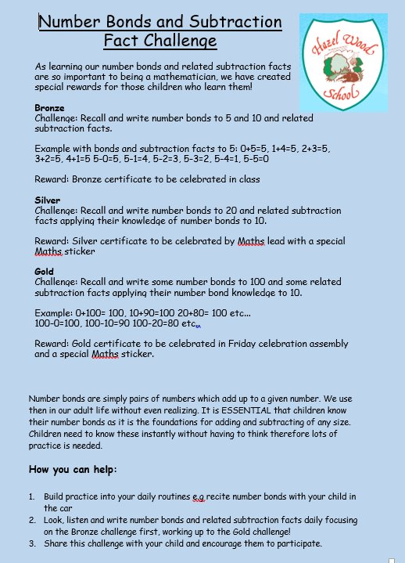
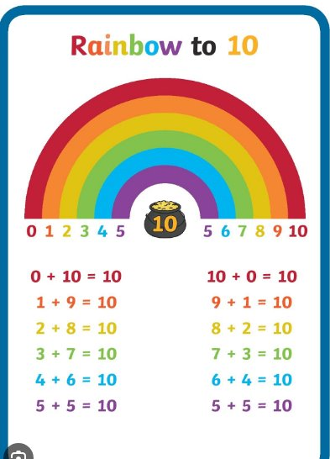
Maths Reward Challenge
Number bonds are vital to supporting children’s understanding and application of mathematical concepts.

Slide 10
Key information for Beech Class
We swap phonics books every Wednesday.
Please make sure your child brings their library book every Thursday.
We change banded reading books on Fridays, so don’t forget to send them in ready to be swapped.
Children should come to school in their PE kits on their PE days which are on a Tuesday and Wednesday.

Slide 11
We look forward to your child joining us in Beech Class!
If you have any questions, please don’t hesitate to ask any of the members of staff.

