Slide 1


Yayoi Kusama
The Federation of Hazel Wood and Lydlynch Infant Schools
Key Stage 1
Autumn 1 2022
1 week project
Focused Learning Value: Creativity

Slide 2
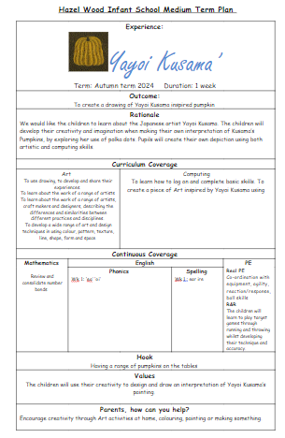
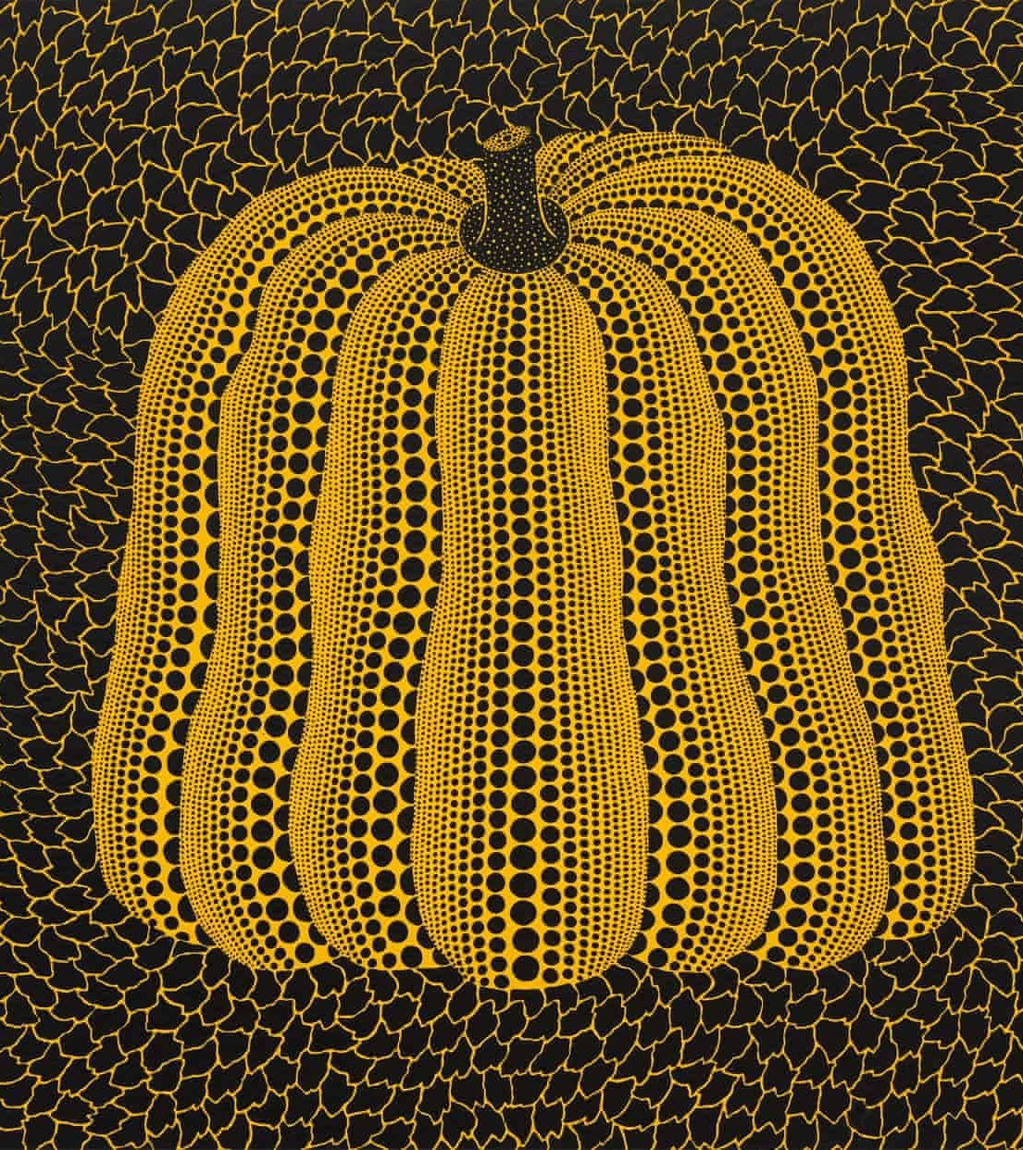
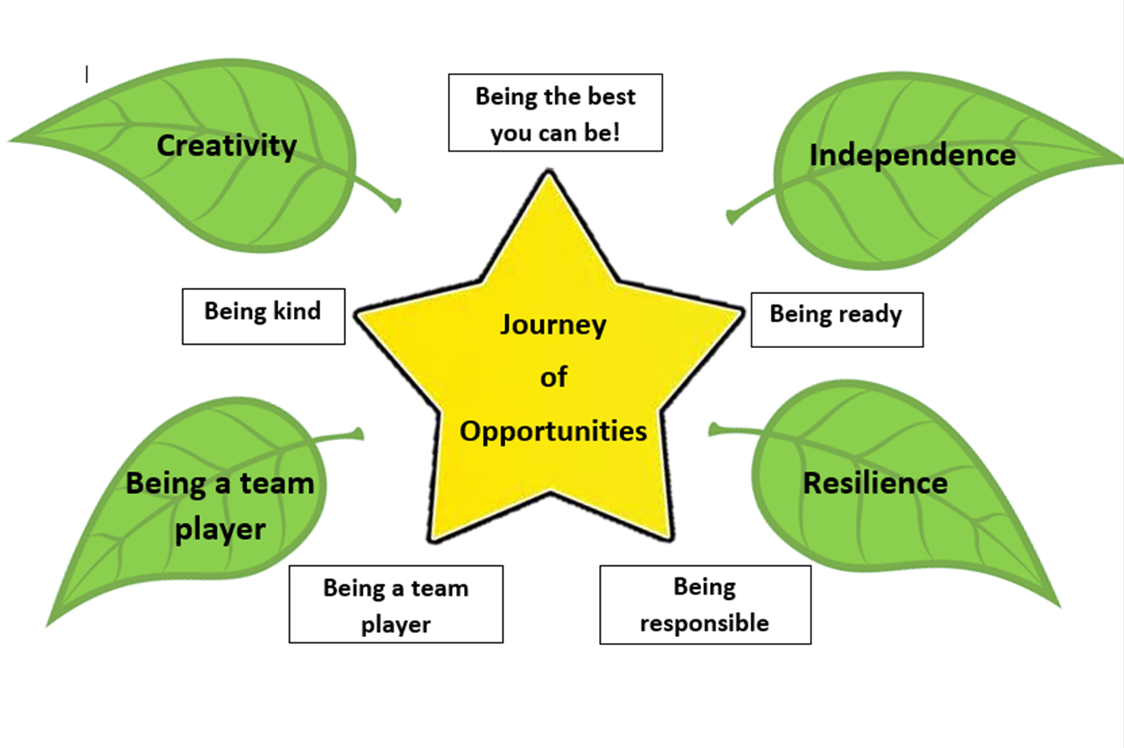
In KS1 we have been creating art inspired by the contemporary Japanese artist and sculptor, Yayoi Kusama.

Slide 3

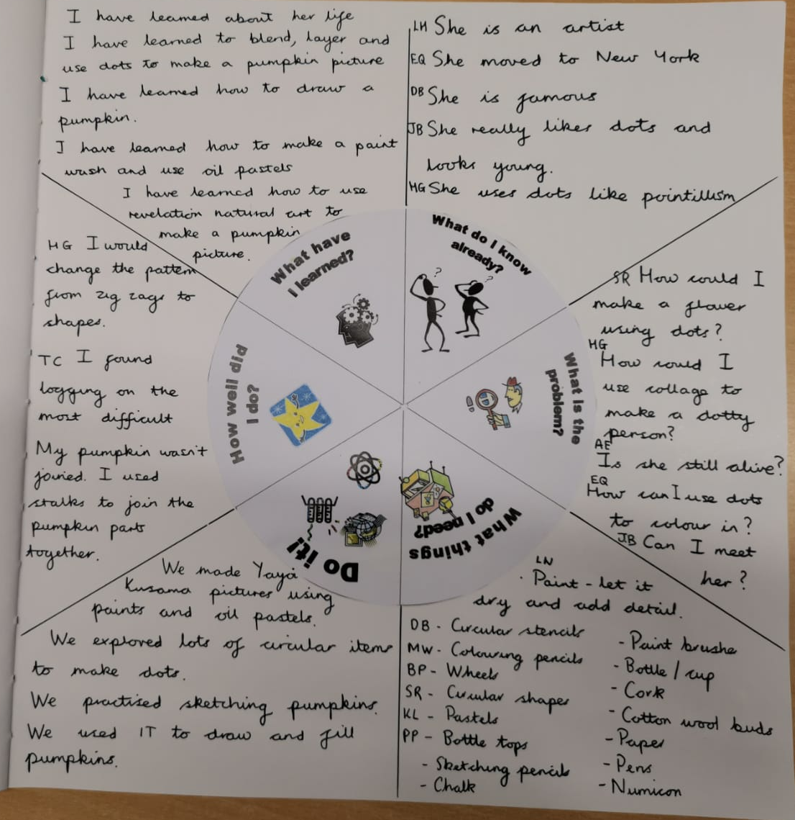

The Hook
We learnt about a famous artist called 'Yayoi Kusama'. After reading her story about why she became famous we learnt that 'dots' were a big feature on all of her work.
We learnt how to draw a pumpkin and used Yayoi's technique of filling in the object using different sized dots. We used different tools such as cotton buds, finger prints, paintbrush and oil pastels.

Slide 4
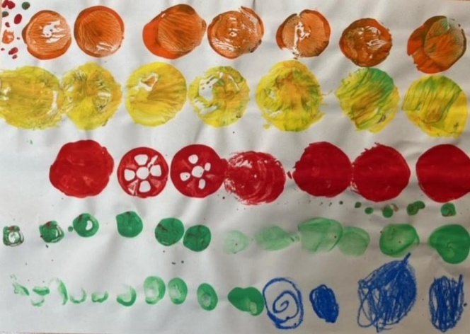
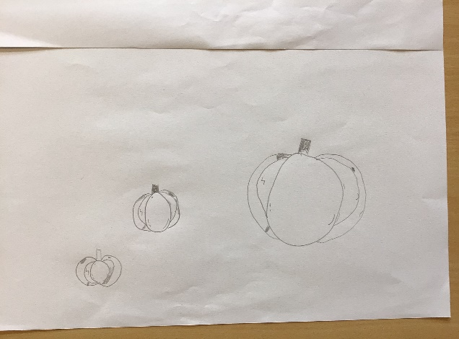
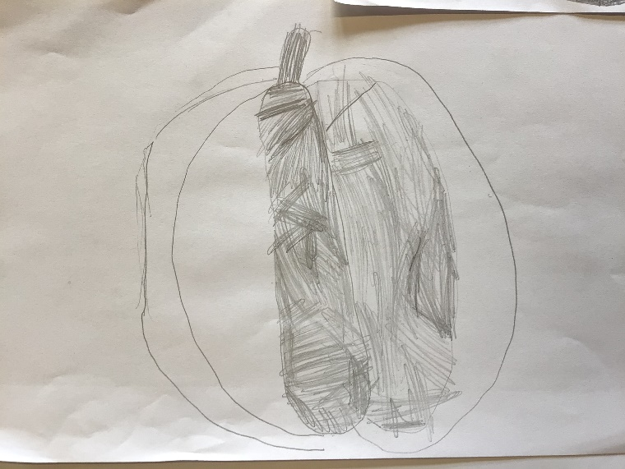
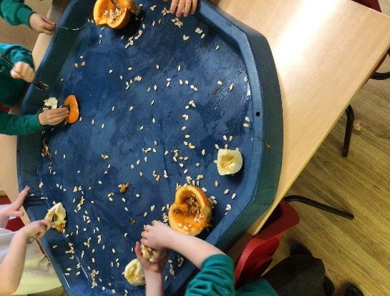
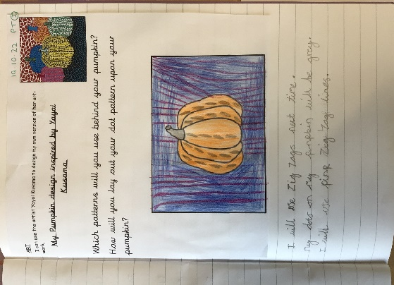
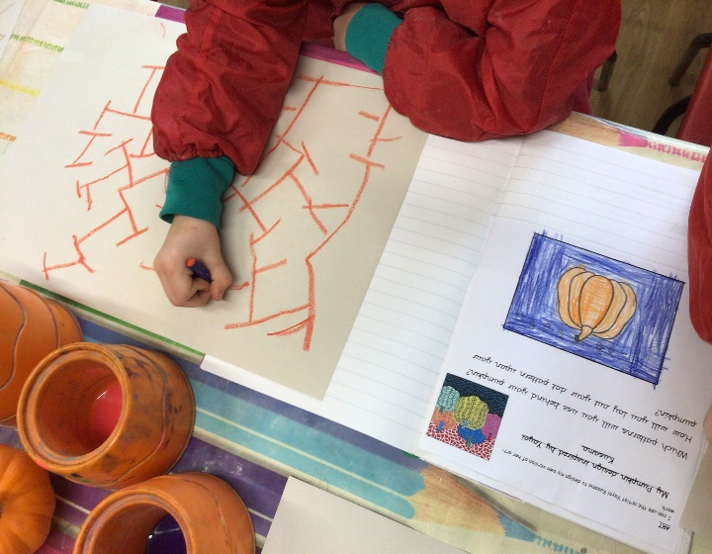
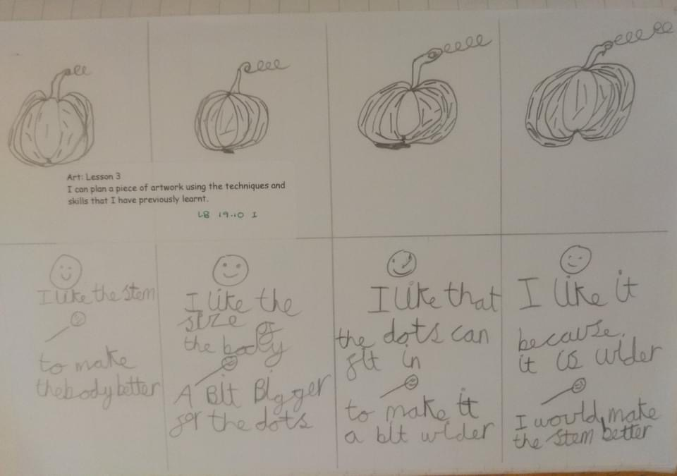
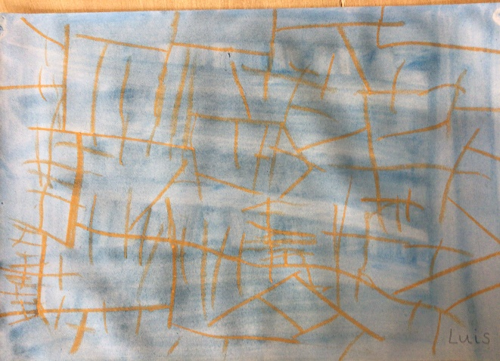
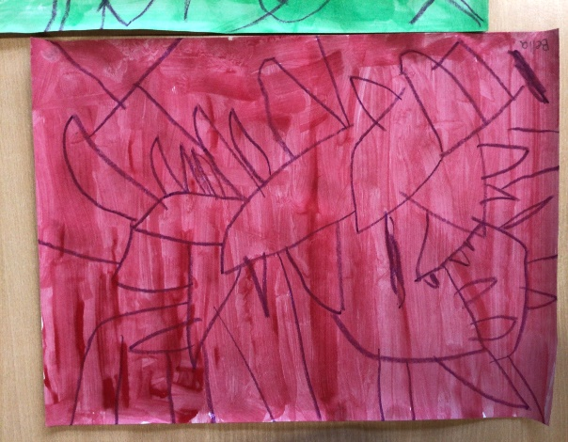
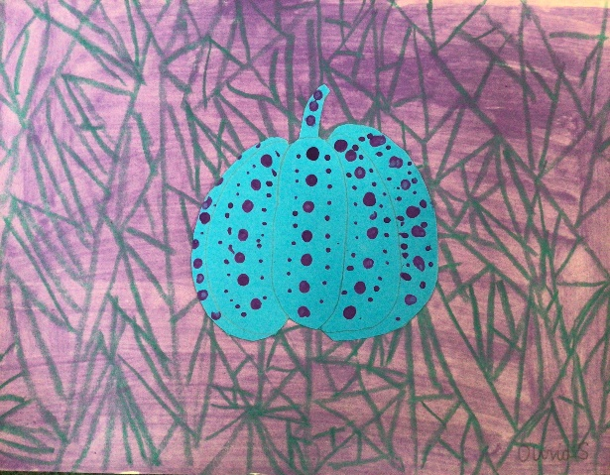
How have we been creative?
We explored, printed, observed, drew and used our imaginations.

Slide 5
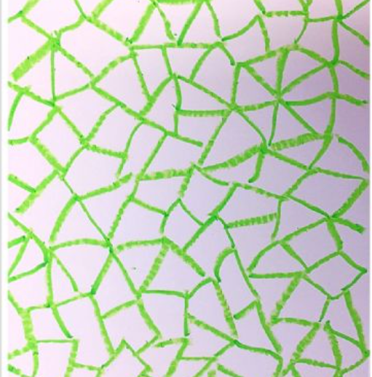
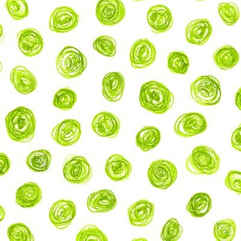

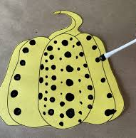

I can use the artist Yayoi Kusama to inspire my own creation
We began by covering our paper with a pattern in oil pastel.
Some of us chose to use dots and others irregular triangles.
Once the pattern was complete, it was time to add paint.
We then drew and cut out pumpkins in a contrasting colour.
We painted our dots in patterns.

Slide 6
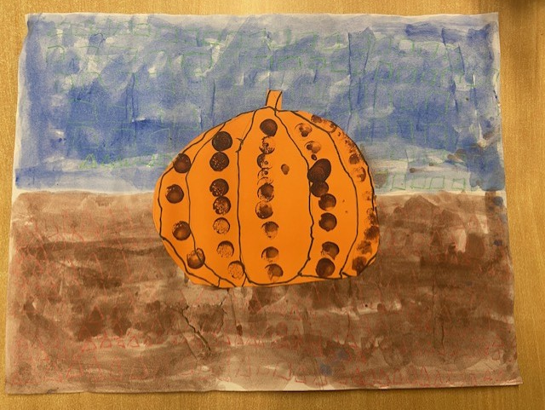
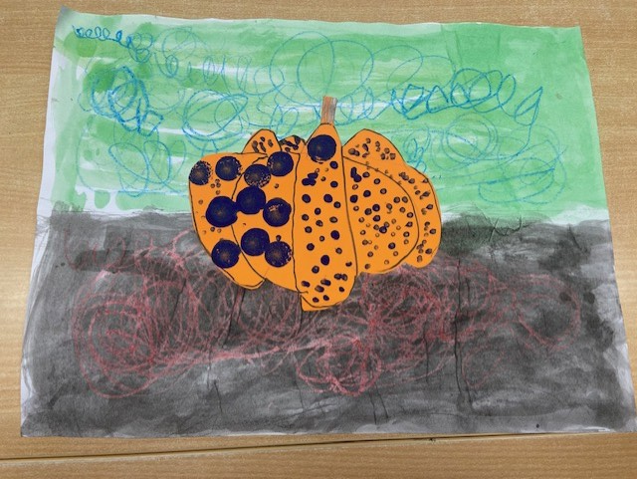
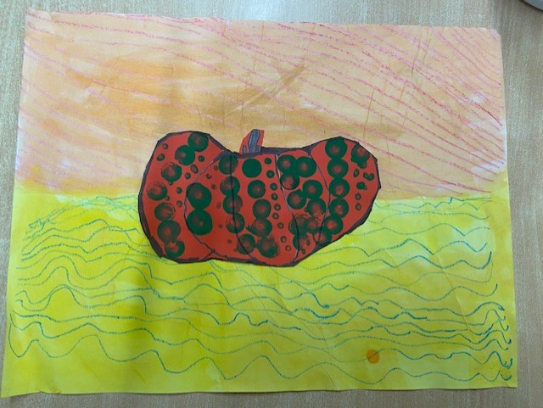
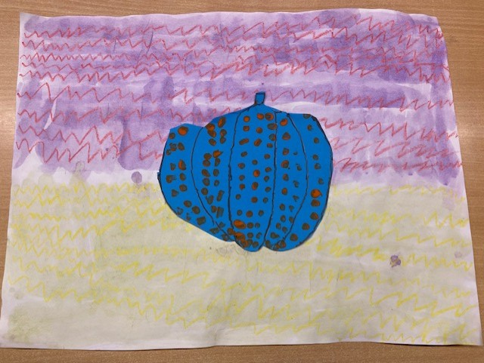
Examples of our final creations:

Slide 7
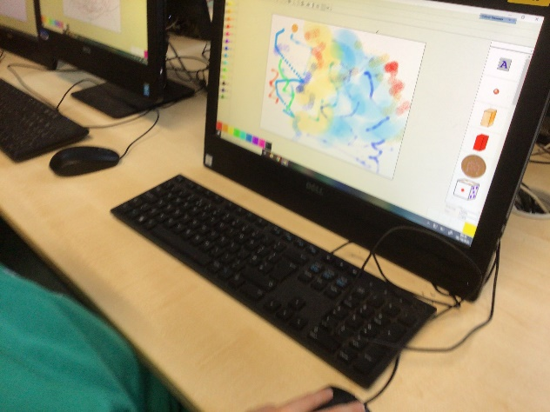
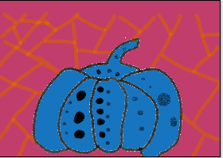
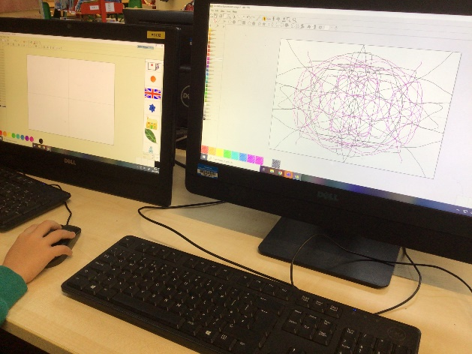
Computing
We have also been learning the basic skills of how to use a computer. We have learnt how to log on, open up Revelation Natural Art and log off safely. We also have learnt how to create a picture inspired by Yayoi Kusama using our computing skills.

